Slide 1
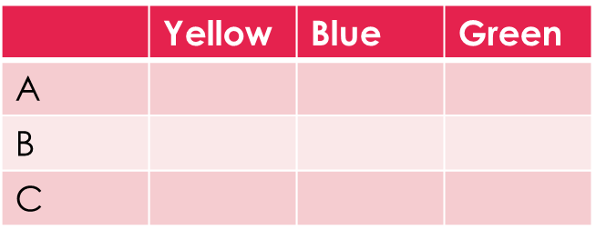
Topic: Probability - Tree Diagrams EQ: How can we show two –step problems with tree diagrams?
Steps to be successful this lesson:
Get materials out (notebook, pen, pencil, ruler, calculator)
Rule up notebook and write Topic and EQ
Start on review questions →
Check your answers with someone sitting next to you
Is your notebook up to date? (Contents page, glossary, review notes etc.)
Review questions (on LHS)
There is a bag with 3 marbles (yellow, blue, green) and 3 pieces of paper with letters (A, B, C). Complete the two way table:
P(yellow and A) =
P(complement of Blue) or P(B’) =
P(C) =

Slide 2
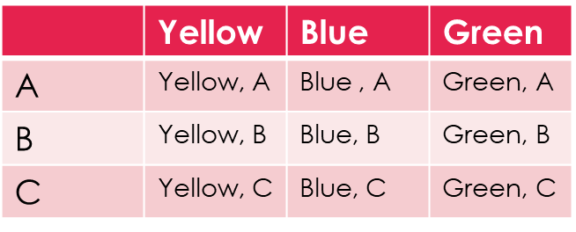
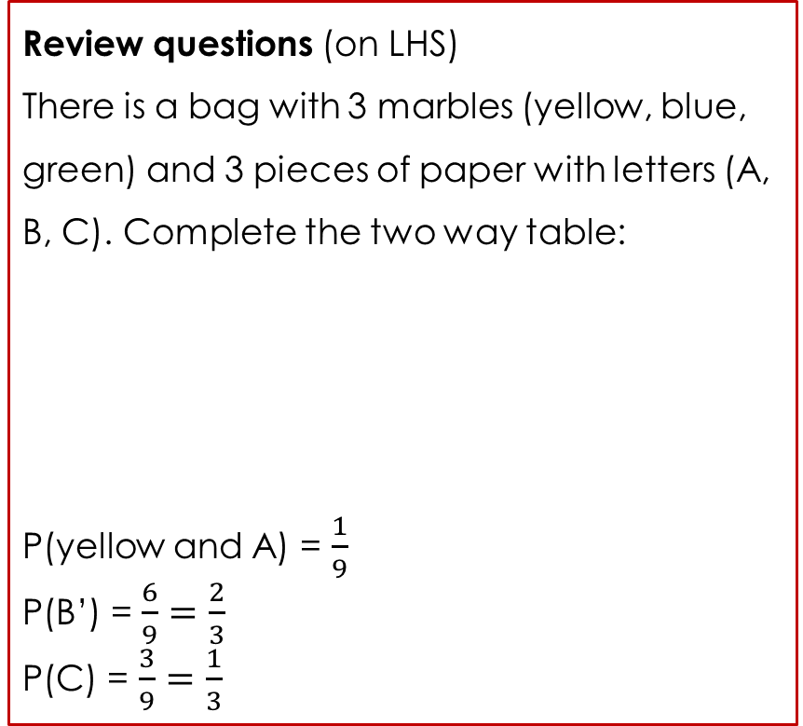
Topic: Tree Diagrams EQ: How can we show two –step problems with tree diagrams?
Review questions (on LHS)
There is a bag with 3 marbles (yellow, blue, green) and 3 pieces of paper with letters (A, B, C). Complete the two way table:
P(yellow and A) = $\frac{1}{9}$
P(B’) = $\frac{6}{9}=\frac{2}{3}$
P(C) = $\frac{3}{9}=\frac{1}{3}$
Steps to be successful this lesson:
Get materials out (notebook, pen, pencil, ruler, calculator)
Rule up notebook and write Topic and EQ
Start on review questions →
Check your answers with someone sitting next to you
Is your notebook up to date? (Contents page, glossary, review notes etc.)

Slide 3
Tree Diagrams Yr 10 Probability Lesson
EQ: How can we show two –step problems with tree diagrams?

Slide 4
24
7
30
Topic: Tree Diagrams
Date:
EQ – How can we show two step problems with tree diagrams?
The probability of compound events combines at least two simple events, either the union of two simple events or the intersection of two simple events.
The probability that a coin will show head when you toss only one coin is a simple event. However, if you toss two coins, the probability of getting 2 heads is a compound event because once again it combines two simple events.
When the outcome of one event does not affect the outcome of another event, the two events are said to be independent.
What is an independent event?

Slide 5
24
7
30
Topic: Tree Diagrams
Date:
EQ – How can we show two step problems with tree diagrams?
When the outcome of one event does not affect the outcome of another event, the two events are said to be independent.
When two events are independent, you can use the following formula. probability(A and B) = probability(A) × probability(B)
What is an independent event?

Slide 6
24
7
30
Topic: Tree Diagrams
Date:
EQ – How can we show two step problems with tree diagrams?
What is a tree diagram?
Tree diagrams are another useful way of creating representations of compound (multi step events). Each outcome is represented on a “branch”
For a coin toss we can have a heads or a tails. What happens if we toss two coins?

Slide 7
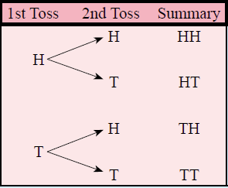

24
7
30
Topic: Tree Diagrams
Date:
EQ – How can we show two step problems with tree diagrams?
What is a tree diagram?
Tree diagrams are another useful way of creating representations of compound (multi step events). Each outcome is represented on a “branch”
For a coin toss we can have a heads or a tails. What happens if we toss two coins?

Slide 8
24
7
30
Topic: Tree Diagrams
Date:
EQ – How can we show two step problems with tree diagrams?
What is a tree diagram?
Tree diagrams are another useful way of creating representations of compound (multi step events). Each outcome is represented on a “branch”
For a coin toss we can have a heads or a tails. What happens if we toss two coins?

Slide 9
24
7
30
Topic: Tree Diagrams
Date:
EQ – How can we show two step problems with tree diagrams?
What is a tree diagram?
Tree diagrams are another useful way of creating representations of compound (multi step events). Each outcome is represented on a “branch”
For a coin toss we can have a heads or a tails. What happens if we toss two coins?
4 outcomes
Heads then Heads = 0.25
Heads then Tails = 0.25
Tails then Heads = 0.25
Tails then Tails = 0.25
What is the probability of getting one of these outcomes?

Slide 10


Slide 11
Activity: Class based tree diagram
Step 1. Organise yourself into two groups– Short hair and Log hair. Short hair people on the left, long hair on the right.
Notes:
Dark hair, not dark hair
Short hair, long hair
Alternatives: boy / girl, shorts/pants

Slide 12
Activity: Class based tree diagram
Next, in your groups, split into two smaller groups: Light and dark hair colours
Number of Short hair
Number of Long hair
5

Slide 13
Activity: Class based tree diagram
Outcome
Light hair
Short and Light hair
Short hair
Dark hair
Short and Dark hair
Long and Light hair
Light hair
Long hair
Long and Dark hair
Dark hair
5

Slide 14
Activity: Class based tree diagram
In your note books, record down the number of people in each of the four groups, then find out the probability of each group.
Remember:
Number in group / Total members in class.

Slide 15




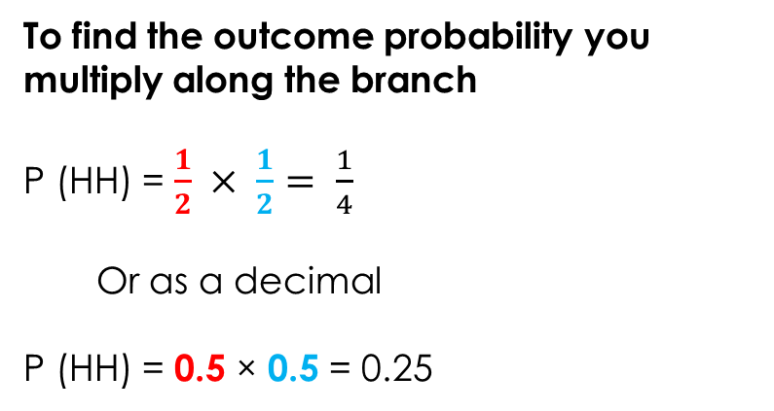


24
7
30
Topic: Tree Diagrams
Date:
EQ – How can we show two step problems with tree diagrams?
Using the same example as before:
What was the probability of getting heads or tails for the first toss?
We know these are the 4 outcomes
Heads then Heads = 0.25
Heads then Tails = 0.25
Tails then Heads = 0.25
Tails then Tails = 0.25
How do you calculate the probability from a tree diagram?
What was the probability of getting heads or tails for the second toss?
$$\frac{1}{2}$$
To find the outcome probability you multiply along the branch
P (HH) = $\frac{1}{2} × \frac{1}{2}= \frac{1}{4}$
Or as a decimal
P (HH) = 0.5 × 0.5 = 0.25
$$\frac{1}{2}$$
$$\frac{1}{2}$$
$$\frac{1}{2}$$
$$\frac{1}{2}$$
$$\frac{1}{2}$$

Slide 17
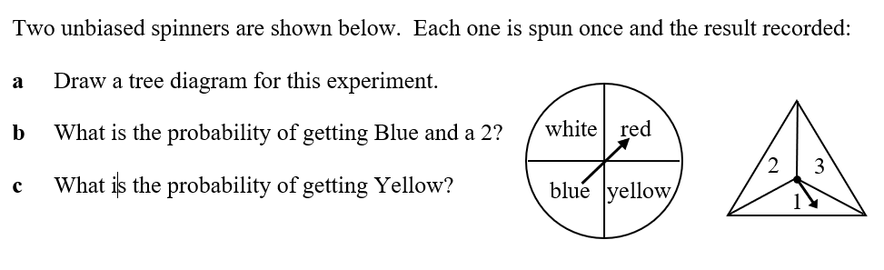






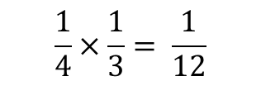



Worked Example
White
Red
Blue
Yellow
1
2
3
1
2
3
1
2
3
1
2
3
$$\frac{1}{4}$$
$$\frac{1}{4}$$
$$\frac{1}{4}$$
$$\frac{1}{4}$$
$$\frac{1}{3}$$
$$\frac{1}{3}$$
$$\frac{1}{3}$$
$$\frac{1}{3}$$
$$\frac{1}{3}$$
$$\frac{1}{3}$$
$$\frac{1}{3}$$
$$\frac{1}{3}$$
$$\frac{1}{3}$$
$$\frac{1}{3}$$
$$\frac{1}{3}$$
$$\frac{1}{3}$$
$$\frac{1}{4}×\frac{1}{3}= \frac{1}{12}$$
P {Blue and 2} =
P{Yellow} =
$$\frac{1}{4}$$

Slide 18
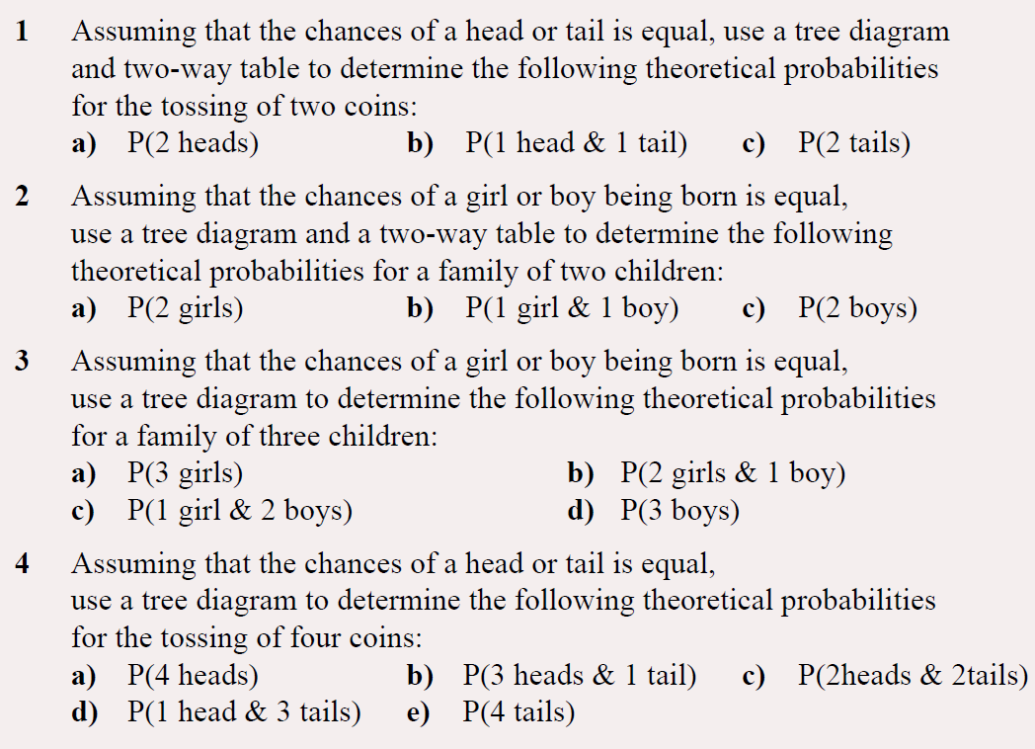
LHS Practise

Slide 19
Tree Diagrams Yr 10 Probability Lesson
EQ: What is probability without replacement?

Slide 20
24
7
30
Topic: Probability
Date:
EQ – What is probability without replacement?
In some experiments, the sample space, (list of possible outcomes) may change for the different events.
The probability for each event will be different. This is called “without replacement”.
Example:
There are 10 marbles in a bag. When you choose one and keep it there were 10 marbles in this first selection.
If you choose another marble and keep it, there are 9 marbles to choose from in the second selection.
What is probability without replacement?

Slide 21
24
7
30
Topic: Probability
Date:
EQ – What is probability without replacement?
When the outcome of one event has the power to affect the outcome of another event, the two events are said to be dependent.
When two events are dependent, you can use the following formula probability(A and B) = probability(A) × probability(B given A)
What is probability without replacement?

Slide 22
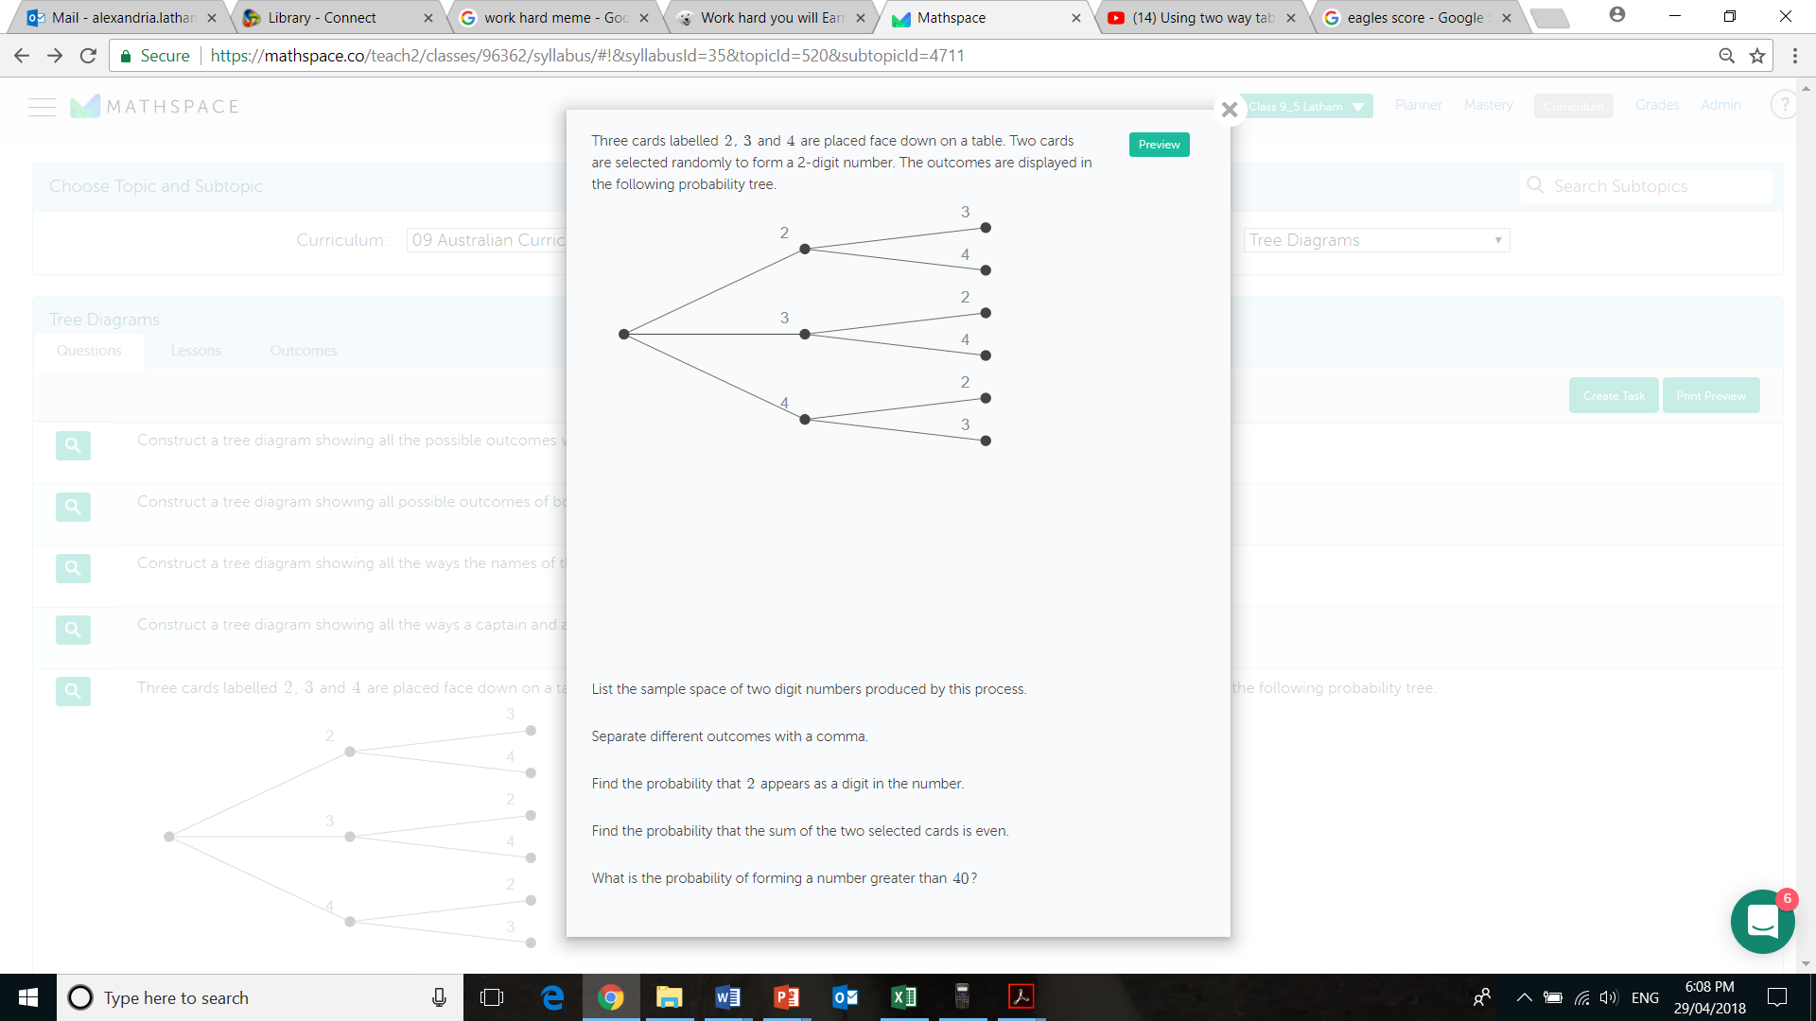
24
7
30
Topic: Two step Probability without replacement
Date:
EQ – What is experimental probability without replacement?
Example
Since the cards are selected at the same time there is no replacement.

Slide 24
24
7
30
Topic: Probability
Date: 13/06/2018
EQ – What is probability without replacement?
How do I calculate probability without replacement?
Step 1: Draw the Probability Tree Diagram and write the probability of each branch. (Remember that the objects are not replaced)
Step 2: Look for all the available paths (or branches) of a particular outcome.
Step 3: Multiply along the branches and add vertically to find the probability of the outcome.
Remember that each branch can change and you will need to figure out each one!

Slide 25
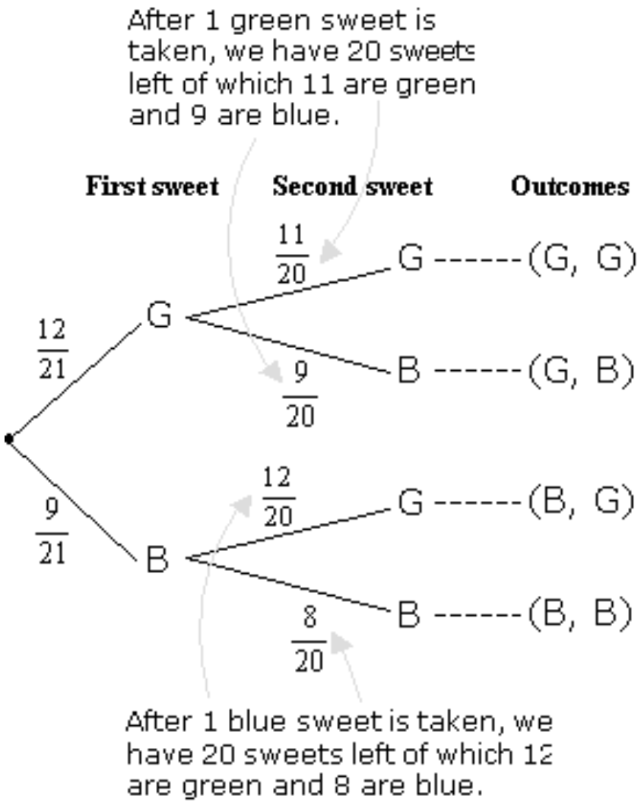
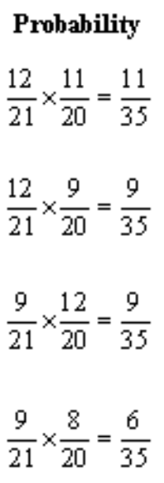
24
7
30
Topic: Probability
Date: 13/06/2018
EQ – What is probability without replacement?
A jar consists of 21 sweets. 12 are green and 9 are blue. William picked two sweets at random.
Example
a) Draw a tree diagram to represent the experiment.

Slide 26
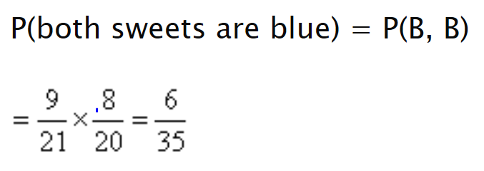
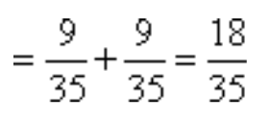
24
7
30
Topic: Probability
Date: 13/06/2018
EQ – What is probability without replacement?
A jar consists of 21 sweets. 12 are green and 9 are blue. William picked two sweets at random.
Example
a) Draw a tree diagram to represent the experiment.
b) Find the probability that i) both sweets are blue.
ii) one sweet is blue and one sweet is green.
= P(G,B) + P(B,G)

Slide 27
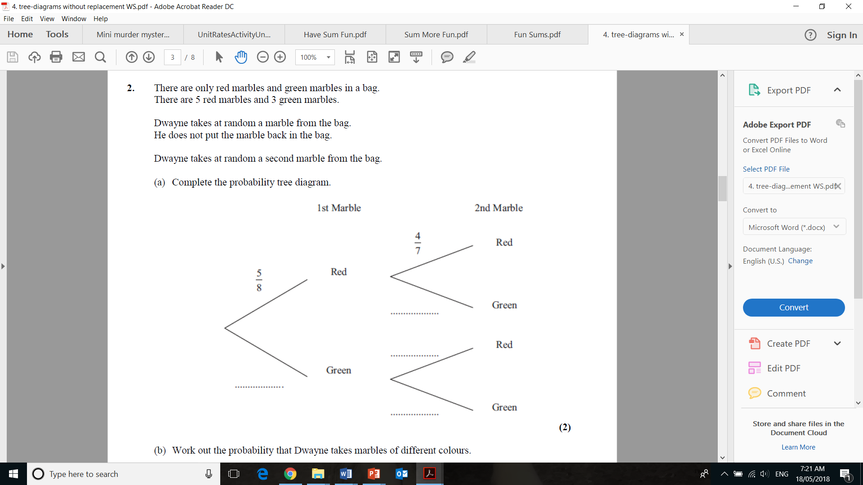
Task

Slide 28
Task
Add “compound event”, “dependent event”, “independent event” and “tree diagram” to your glossary.
Complete Ex 6.2 from Nelson WA Maths pg 247: 10 Q10, 11, 15, 16, & 21 or Ex 8.4 from Dwyer 10 Maths pg 107 ALL questions
Make sure that your contents page is updated
Write your summary for the lesson

